Slide 1
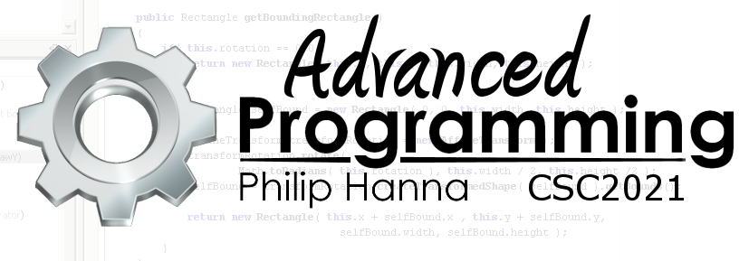
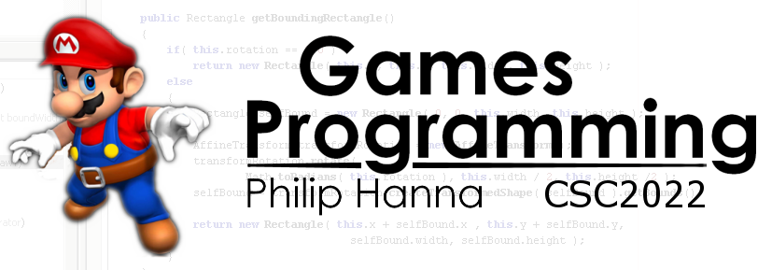
UX Design
Designing with the user’s experience in mind.
Part 5 – Thinking

Slide 2

How People Think

Slide 3

Using mental models
People create and use mental models. The models establish user expectations and are based on the user’s knowledge and prior experience of related/similar things.
An intuitive interface helps the user by adhering to common mental models (of how software is used).

Slide 4

We can’t really multitask
We like to think we can multitask. The reality is that we can only attend to one task at a time.
Directing our attention between tasks is what we term multi-tasking. Doing this require effort.
Aside: An often repeated physical activity (controlling a car) can often be carried out alongside a mental task.

Slide 5
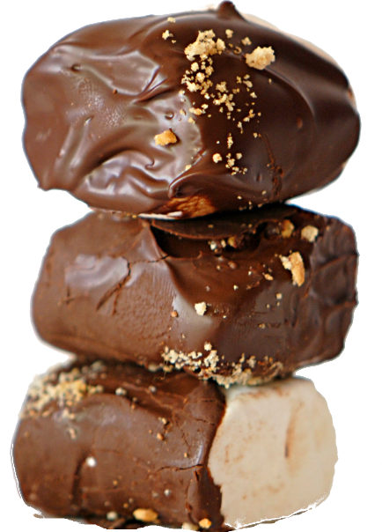
Progressive Disclosure
Giving all the information at once can often be a bad idea (it can overwhelm the user).
Progressive disclosure means providing only the information that is needed at the moment (bit-by-bit).
Progressive disclosure works if you know what the user will need or be seeking for at each stage.

Slide 6

Recognition is Easy; Recall is Hard
We can recognise things quickly. Recalling things, without any perceptual cues, typically requires a lot more effort.
Where possible use pictures to convey function. We recognise pictures very quickly, with recognition facilitating the recall of the associated function.
Aside: People recognise and remember objects faster if shown in a canonical perspective (tilted and at a slight angle above).

Slide 7

Feeling Motivated
We tend to be motivated if we feel we are in control and making good progress towards something we want to achieve.
The shorter the distance to the goal, the more motivated we tend to become.

Slide 8
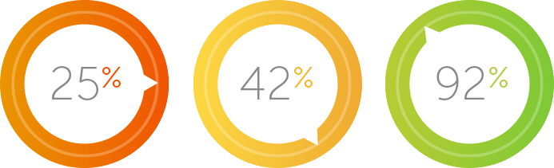
Small Signs of Progress Can Have a Big Effect
Showing the user the progress they are making towards the end goal can have keep the user motivated.

Slide 9

We are inherently lazy
(efficiently so…)

Slide 10

Don’t assume that users will consider all options that are available and choose the best option.
Most of the time we choose the first adequate option that we encounter. Known as satisficing (satisfy + suffice).
Aside: Blame evolution where a quick decision making that avoid ‘bad outcomes’ was typically more important that an ‘optimal’ outcome.

Slide 11
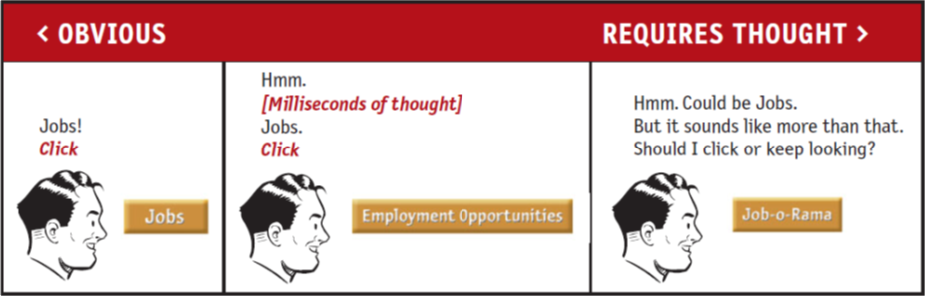
Don’t make me think
The title of a well known book by Steve Kurg and also one of the best ways you can help your user.

Slide 12

Key takeaways:
We tend to satisfice – picking the first plausible option that we find.
We tend to like interactions that are intuitive (they don’t require us to think).
Let users focus on one task at a time. Given them only the information they need at this point in time. Let them know how close they are to completing the task.

